Slide 1
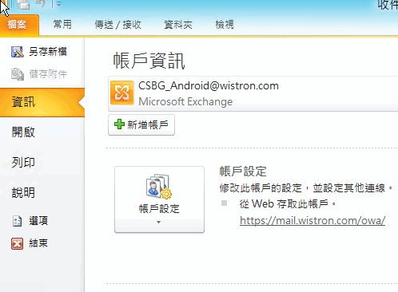
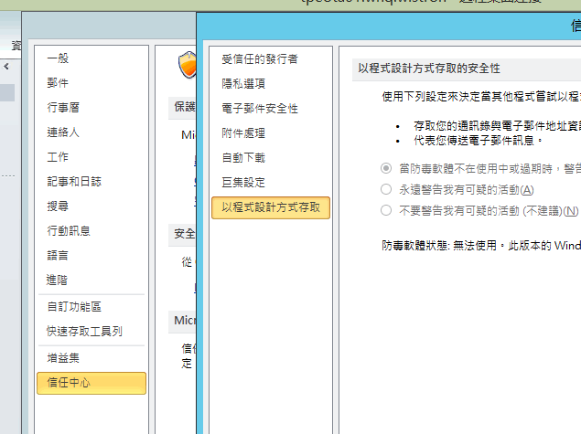
http://technet.microsoft.com/library/ff657852%28Office.14%29.aspx

